Slide 1
Detecting motifs with “drippy” (direct repeats and inverted patterns with python)
Enoch Shin
July 13, 2026

Slide 2
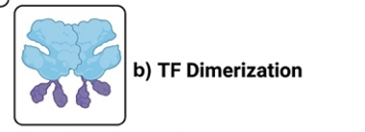
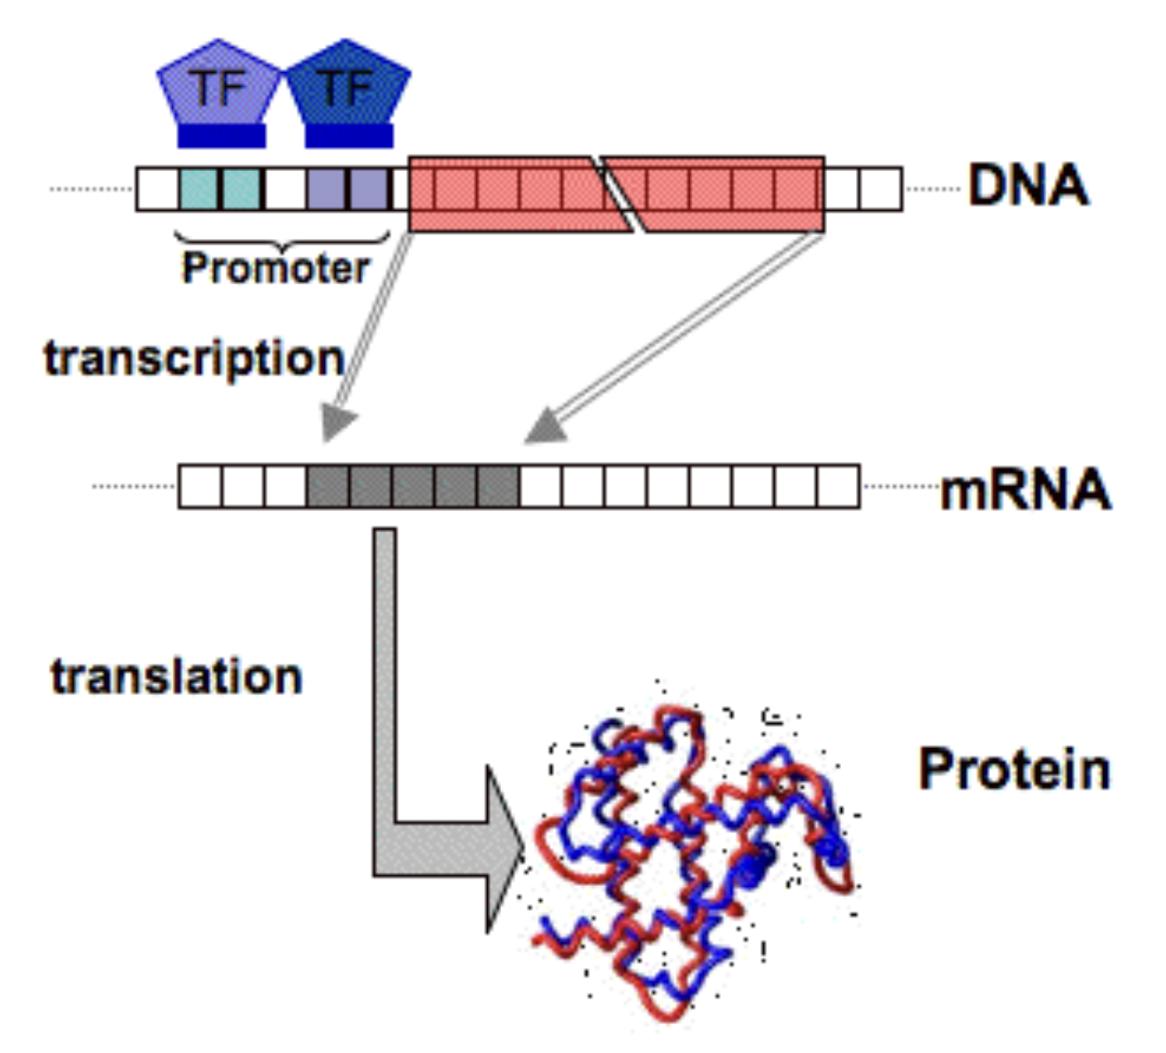
Background: Central Dogma & Motifs
Transcription factor (TF): modulates when, where and how efficiently transcription happens
Motifs: short sequences located in the promoter region, signposts for TFs.
(RNA polymerase)
TF dimerization leads to specific motif sequence patterns:
DR = Direct Repeat
IR = Inverted Repeat = palindrome
(ribosomes)
Saric 2006, Al-Tohamy 2023.
Notes:
TFs – act on promoter region -- motifs within promoted region

Slide 3
Why do we care about finding motifs?
Motifs 🤝 TFs 🤝 Gene expression!
Motifs tell us where and how TFs bind to the genome; useful for:
Chronic genetic diseases
Targeted drug design
Toxicity prediction of peptides and proteins

Slide 4
State of the Art in Motif Discovery
Word-based: dictionary and graph theory
Greedy: iteratively maximize some consensus metric
Probabilistic: Expectation maximization, e.g., MEME
ML/DL: LSTM (Long Short-Term Memory), time series, and deep learning, e.g. DESSO
We are not creating a new discovery method. → new technique to evaluate results

Slide 5
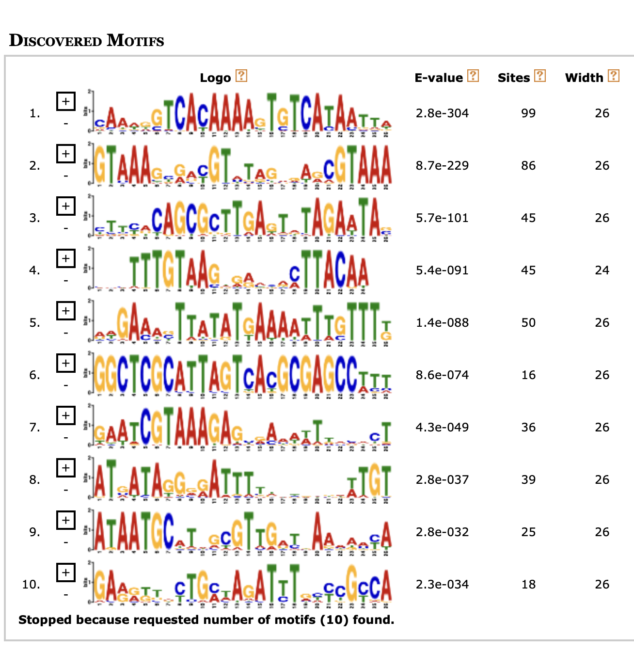
The Problem
How do we know if a search result is likely a real, active motif?
Discovery methods return motif candidates, but we need ways to evaluate quality and curate
MEME’s E-value doesn’t tell us about biological validity

Slide 6
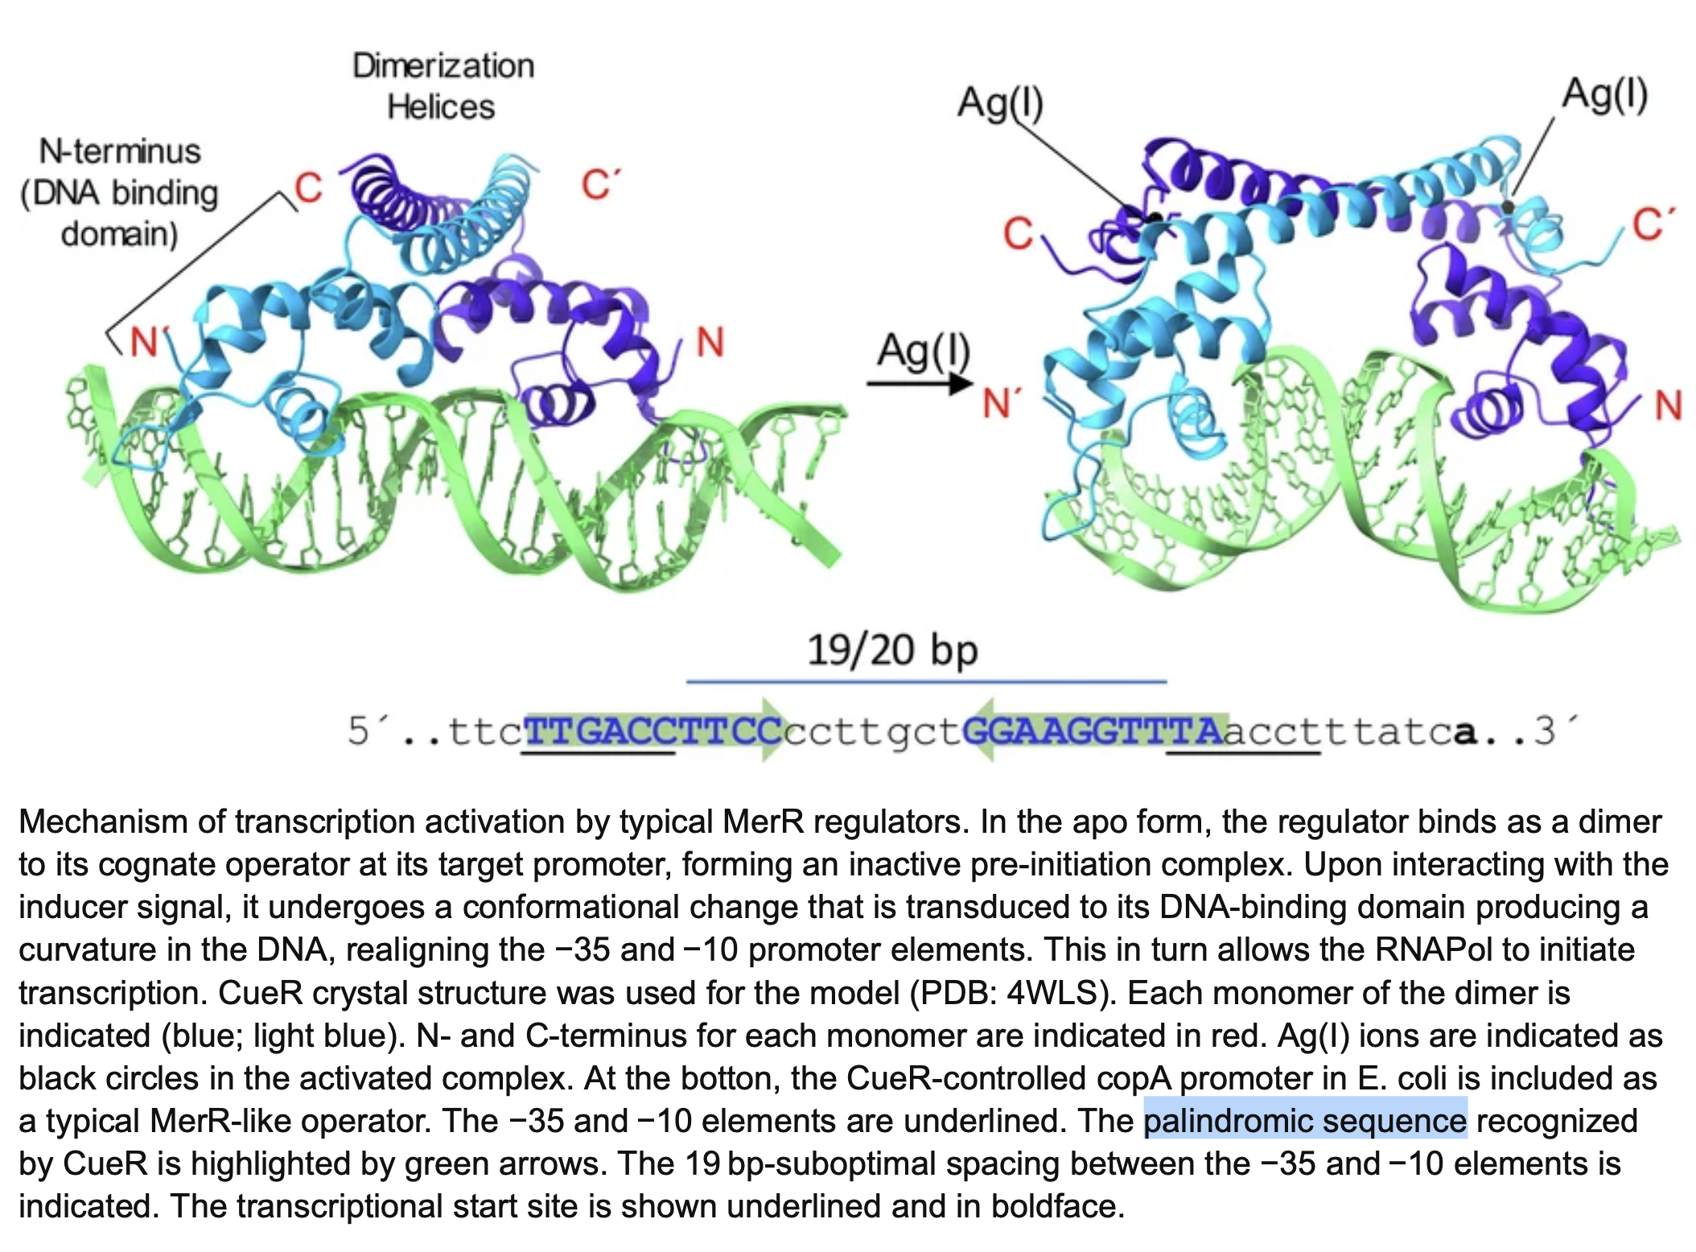
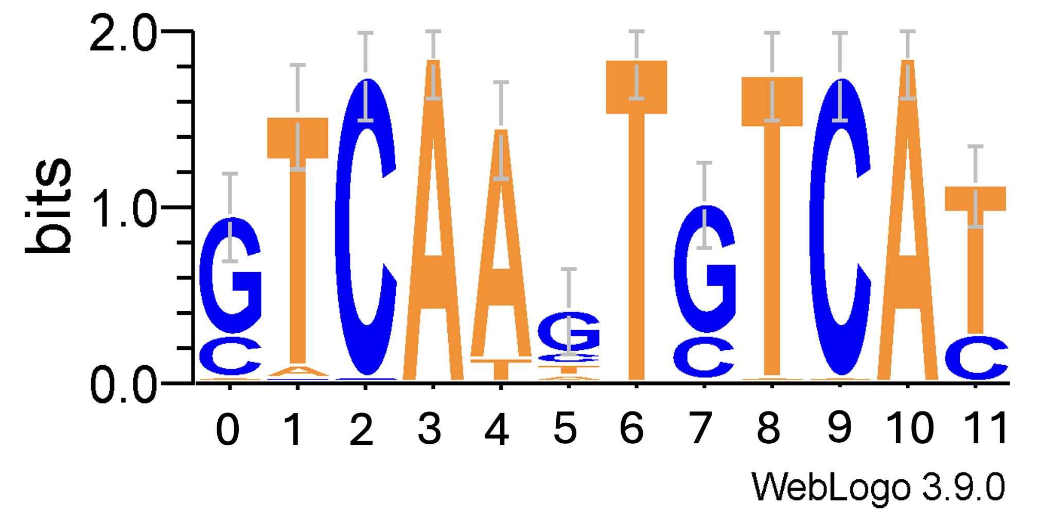
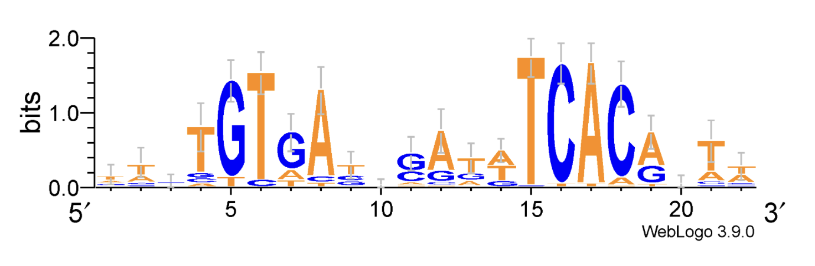
Solution: Find Direct and Palindromic Repeats
Common in Bacterial TF motifs – useful for refining search.
Direct example: GTCA-GTCA
Inverted/Palindrome/Reverse complement example: GTCA → TGAC
A-T, G-C base pairs
Sequence logos visualize potential motifs across sample sequences
Tulin et. Al 2023
Notes:
BIOLOGISTS IDENTIFY MOTIFS BY JUST EYEBALLING SEQUENCE LOGOS
https://www.researchgate.net/publication/376599076_The_multifarious_MerR_family_of_transcriptional_regulators https://www.researchgate.net/figure/Mechanism-of-transcription-activation-by-typical-MerR-regulators-In-the-apo-form-the_fig1_376599076

Slide 7
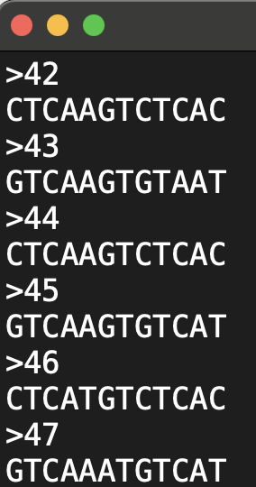
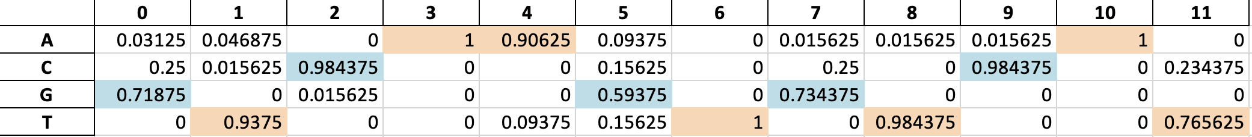
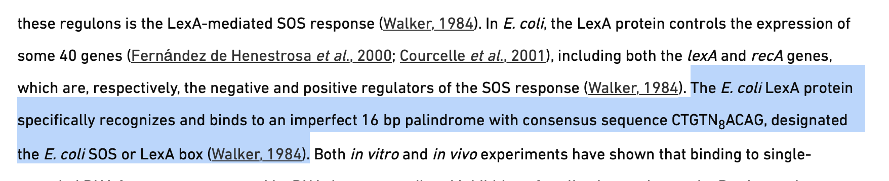
Data Structure & Inputs
CollecTF data, n = 68
FNR-CRP, LexA, and OmpR bacterial TF families
Species with well-studied motifs
Manually labeled DR / IR
.FASTA file format
MEME outputs, n = 40
4 searches with 10 candidates each, labeled DR / IR / none
“Test set”: no information on TF family, reflects real-world search workflow
Mazón & Erill (2004)
Notes:
https://www.microbiologyresearch.org/content/journal/micro/10.1099/mic.0.27315-0

Slide 8
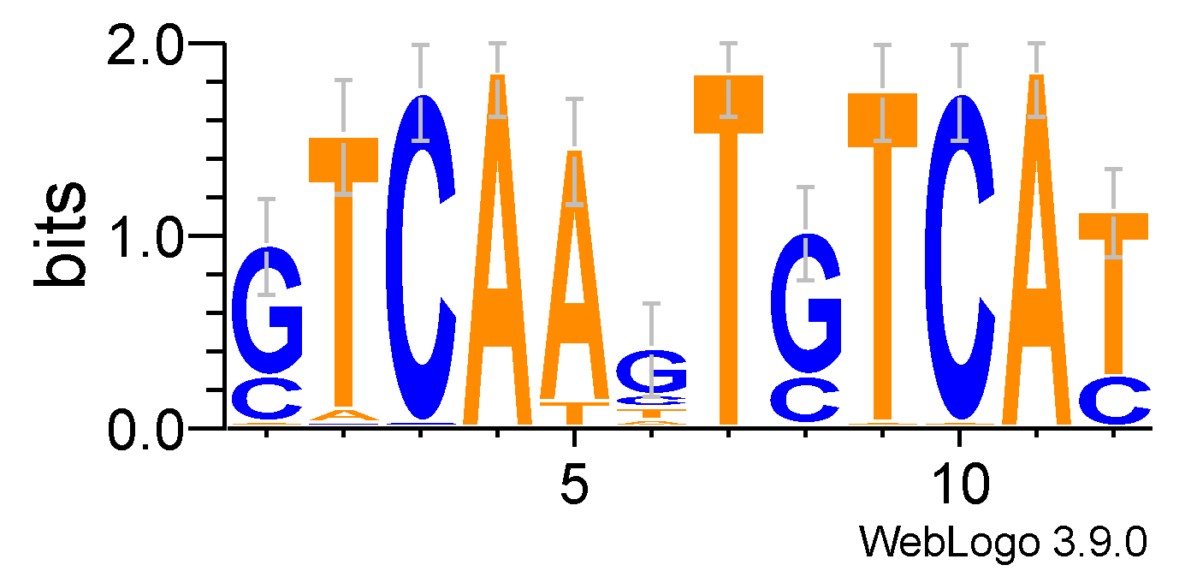
Methodology
Compare probability distributions at pairwise positions
For each index pair, calculate measures of similarity and information
0
1
2
3
4
5
6
7
8
9
10
11

Slide 9
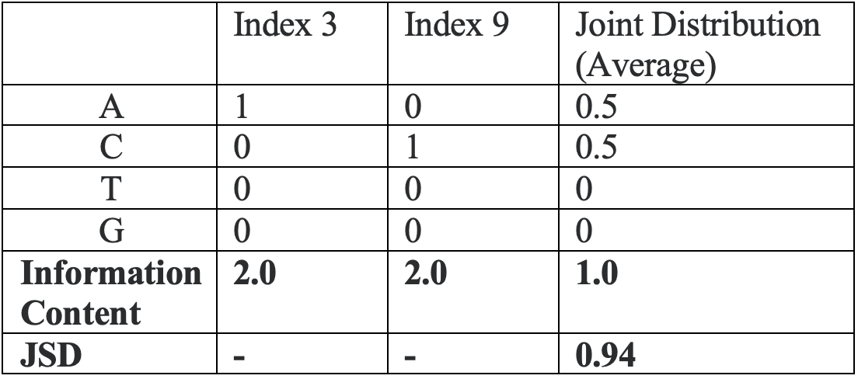
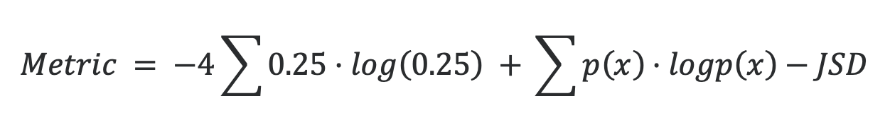
Quantifying Similarity & Metrics Selection
For each index pair, calculate measures of similarity and information
Various metric options
Pearson correlation, Kullback–Leibler, Jensen-Shannon divergence
Our selection
Positional (avg) Info Content – JSD
Information content and divergence penalty
Helps filter out non-DR/IR pairs
0
1
2
3
4
5
6
7
8
9
10
11

Slide 10
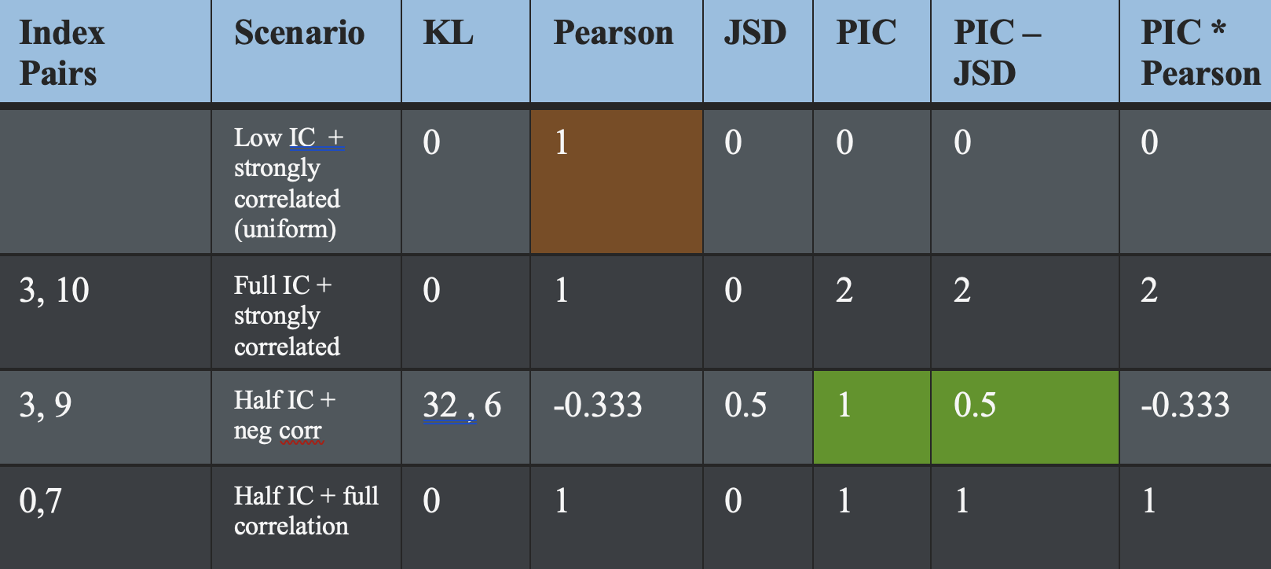
Metrics Selection: Quantifying Similarity
Base Pair | Position A | Position B
A | 0.25 | 0.25
T | 0.25 | 0.25
C | 0.25 | 0.25
G | 0.25 | 0.25

Slide 11
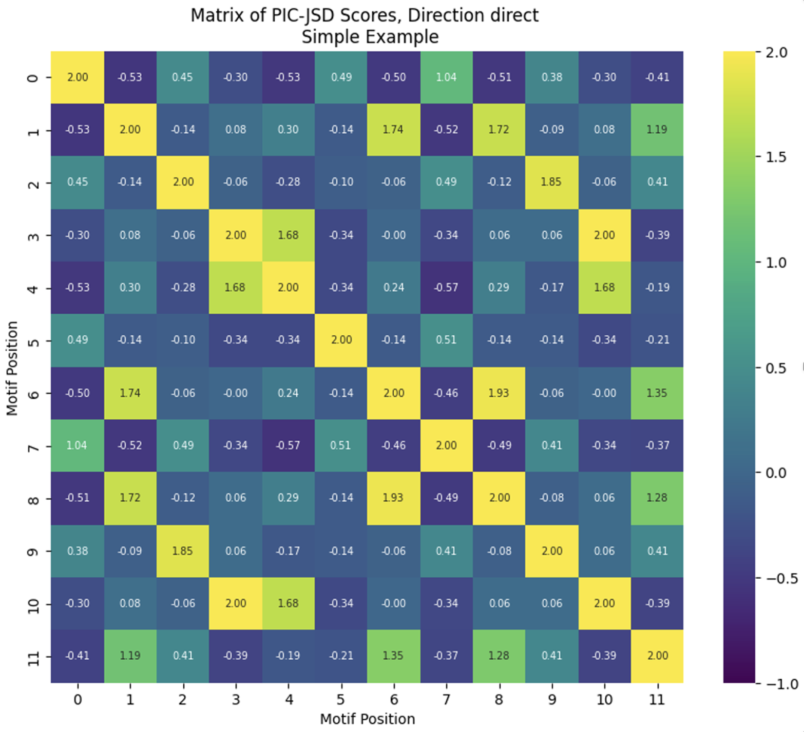
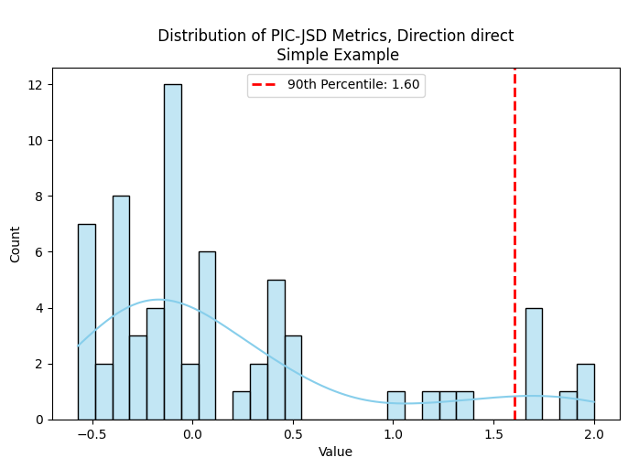
Thresholding and Diagonal Growing
Construct a matrix of our selected measure
Define what constitutes a high value, find diagonal runs for motif candidates
Distribution-based cutoff, e.g. 90th pct: Metric >= 1.60
(8,1) ; (9,2) ; (10,3) = TCA…TCA

Slide 12
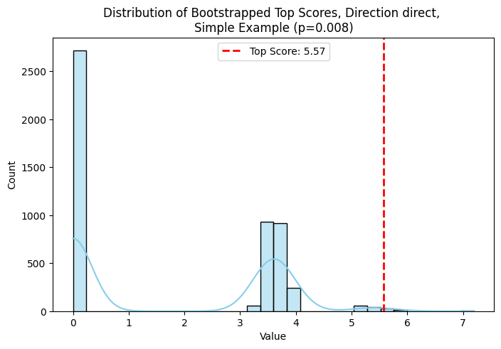
Statistical Strength: Bootstrapping for Evaluation
Sum the cells within diagonals to compute candidate score
Shuffle indices to randomize positional information, perform diagonal growing again
Compare our scores against this distribution of top scores in shuffled space

Slide 13
Classifier Pipeline Overview
Compute PIC – JSD metric for pairwise indices
Direct Repeat
Pick threshold for high metric
Do 2x per observation, DR and IR search
Winner-takes-all: p <= 0.05
Inverted Repeat
Grow continuous diagonals and save candidates
Compare scores to bootstrap
Neither/None
P-value

Slide 14
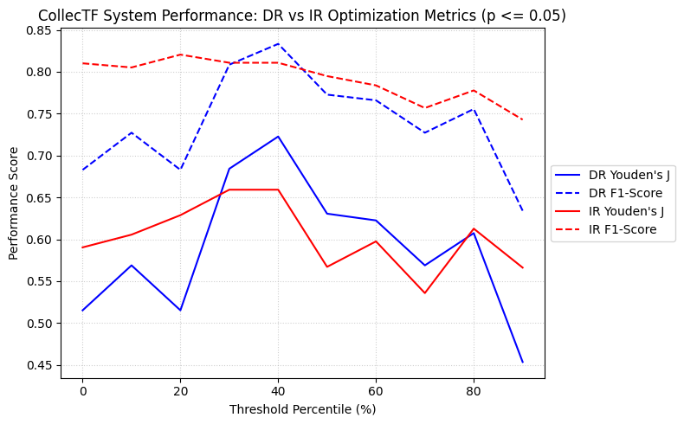
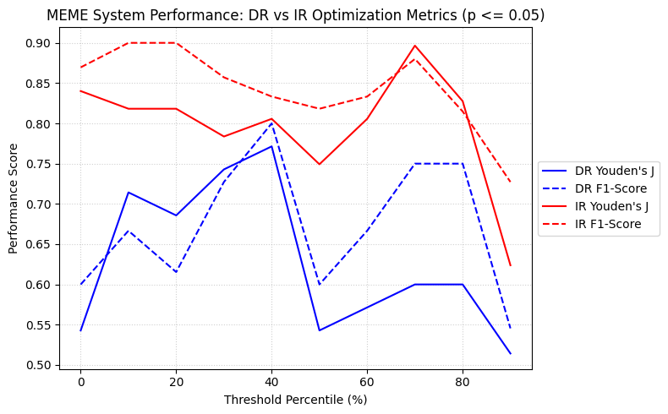
Classification Impact of Percentile Threshold
Defining a “high” metric value: user-selected parameter
Variable results, depends on goals of user (i.e., optimize for DR vs. IR)
Notes:
Youden’s J: Sensitivity + Specificity - 1 = TPR + TNR – 1
F1 – harmonic mean of precision and recall.

Slide 15
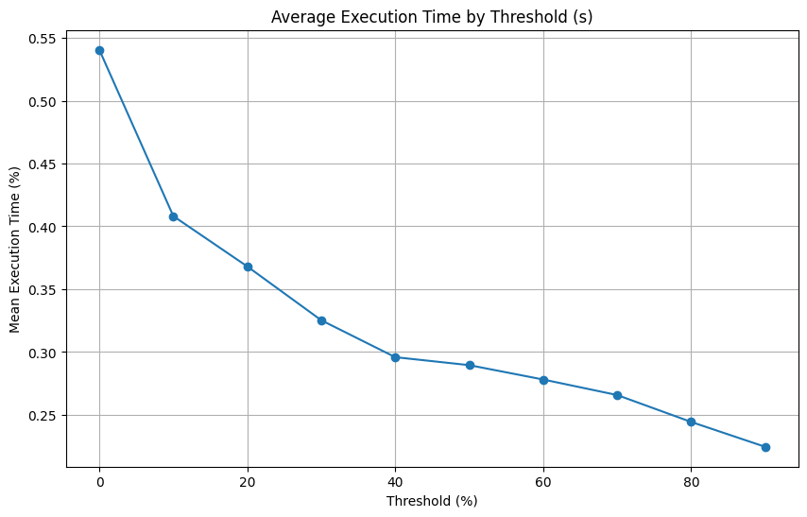
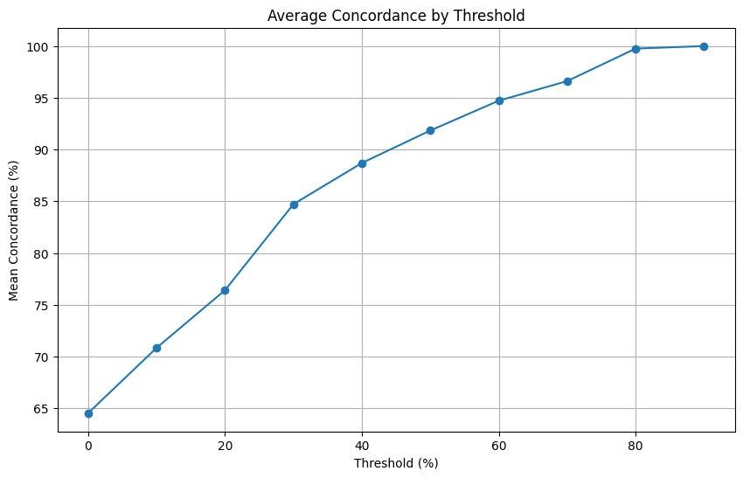
Other Threshold Tuning Considerations
Greedy search: lower threshold = longer compute time
Lower threshold = lower concordance: GTAC…GTAA = 75%
Notes:
Greedy search keeps iterating and expanding diagonals, lower threshold means more accepted candidates
Lower threshold also means fuzzier or ambiguous candidates are likelier to be accepted, leading to imperfect DR IR patterns – biological reality

Slide 16
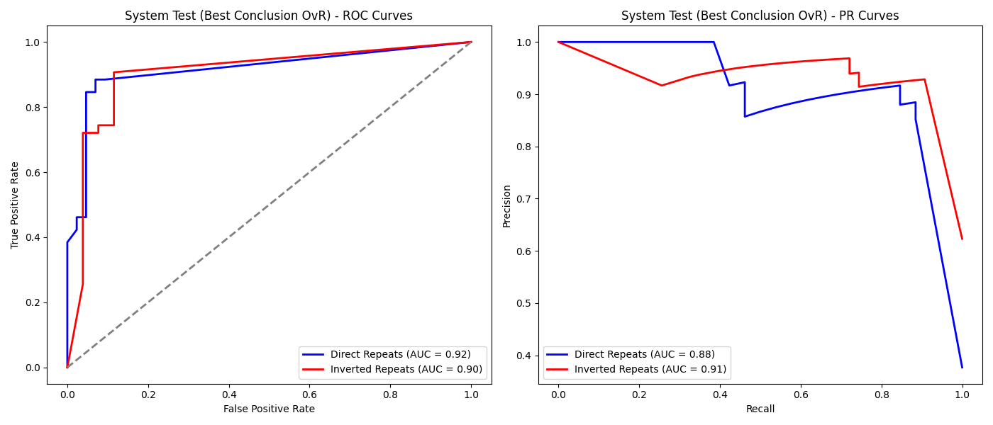
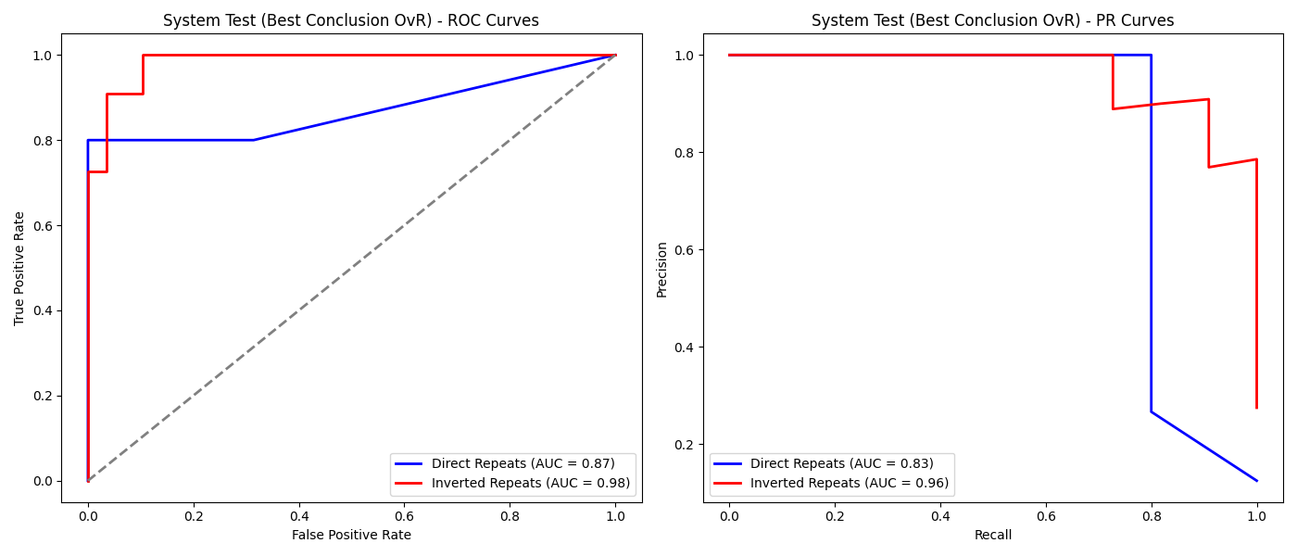
Results
CollecTF, 40% Threshold
In general, IR is better classified
Poorer performance in MEME set
Why: heavy class imbalance
CollecTF: 43 IR, 25 DR
MEME: 11 IR, 5 DR, 24 none
MEME, 70% Threshold
Notes:
Score: 1– bootstrap p-value
ROC: true positive & true negatives
PR: reward true positives but not true negatives, IR better
Why: Imbalanced classes

Slide 17
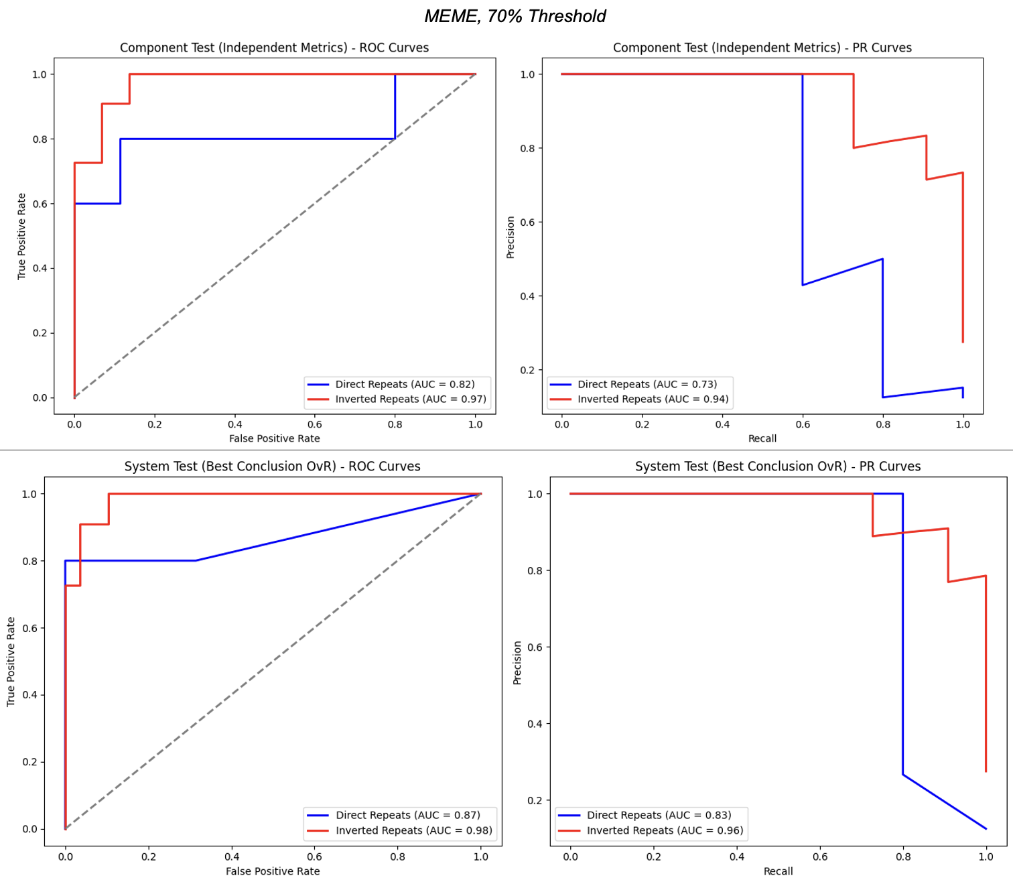
5 DR, 11 IR, and 24 none
Across both ROC and PR, the IR pattern is better classified
Why: class imbalance
Both CollecTF and MEME: combined system – better classification
“Inference” – force a decision between IR and DR search based on consensus p <= 0.05 cutoff

Slide 18
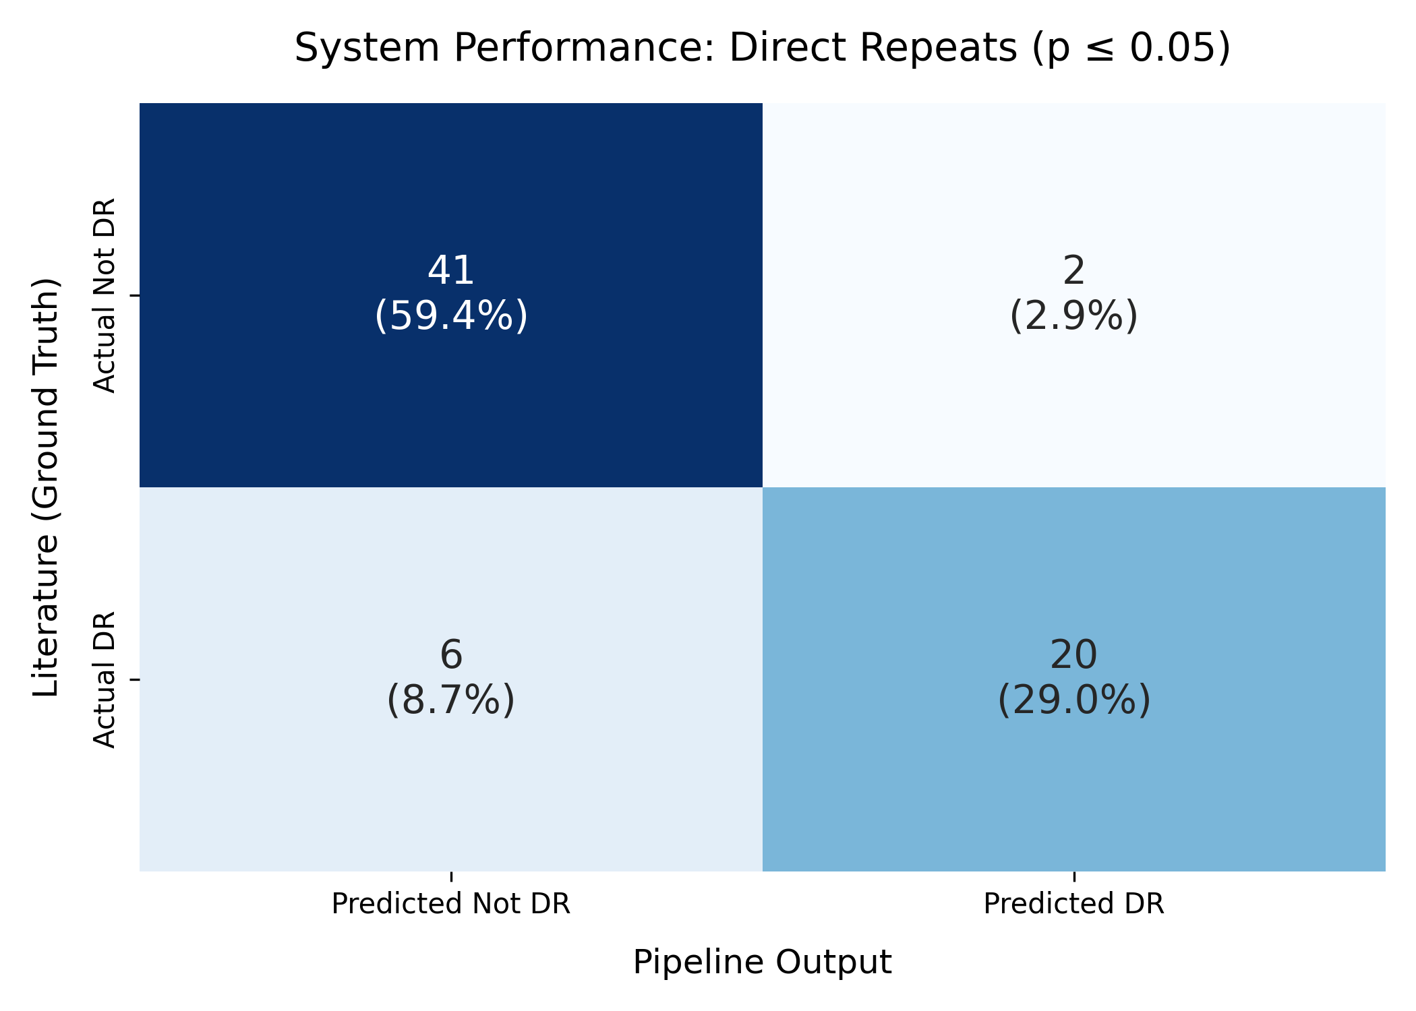
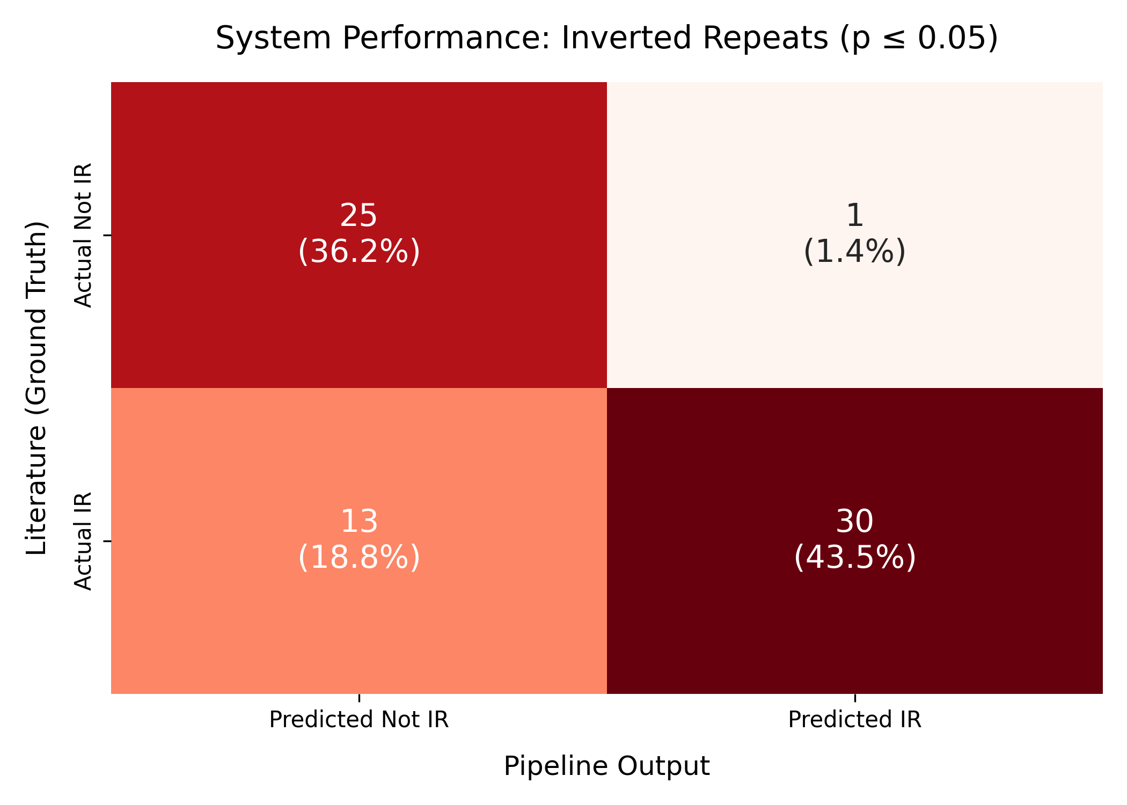
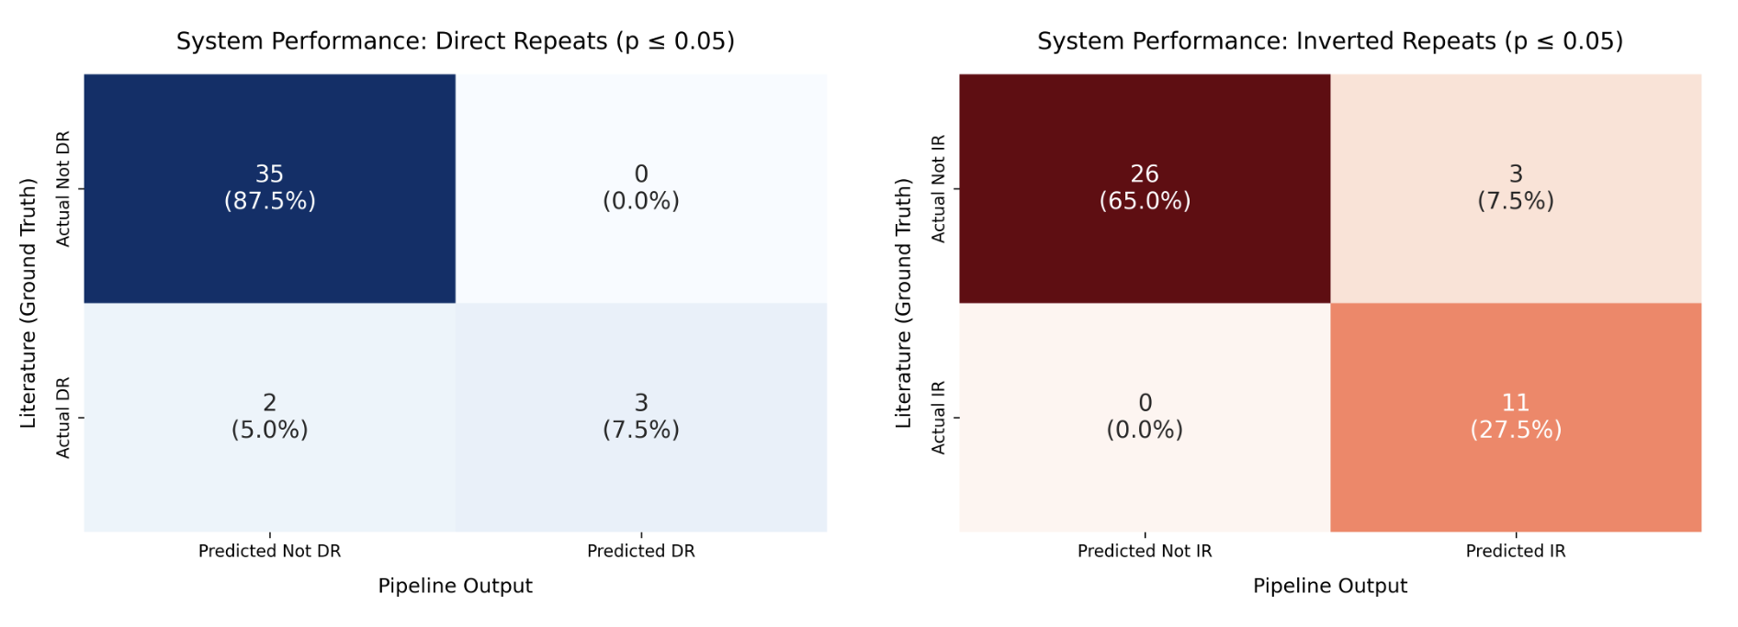
CollecTF, 40% Threshold
Must be either IR or DR
vs. IR, DR, or none
MEME, 70% Threshold
Notes:
Across both data sets --

Slide 19
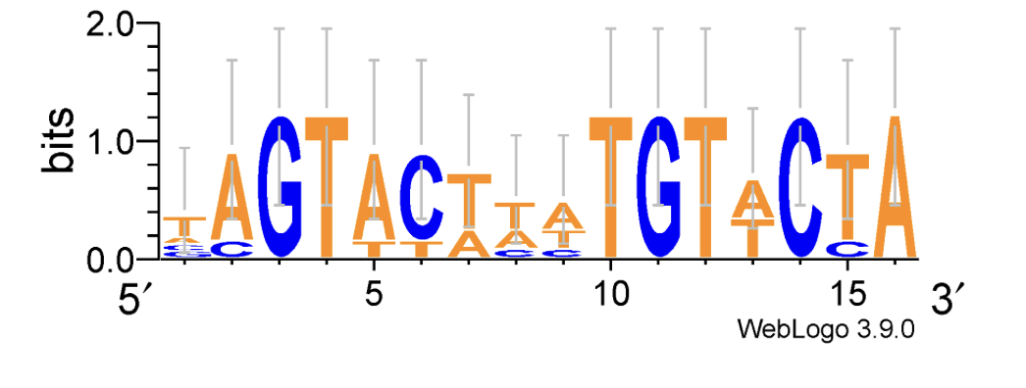
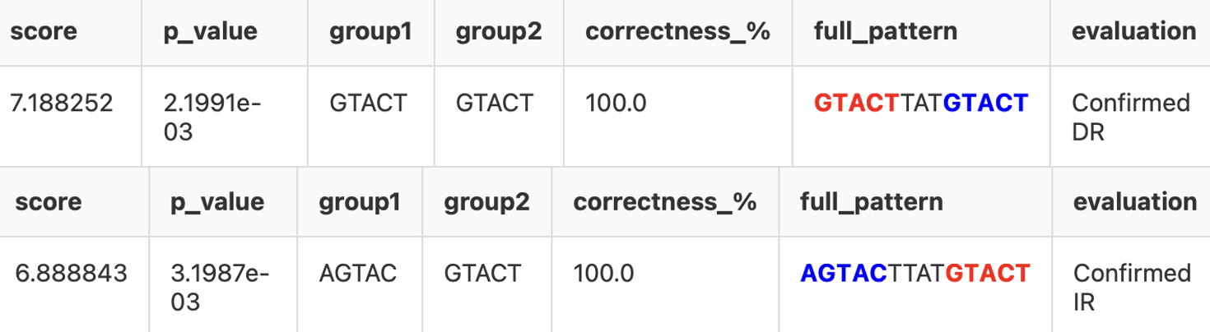
Exceptions and Edge Cases
Nostoc sp. PCC 7120, transcription factor Q8YMM5 (LexA family)
Both a DR and IR
Evolutionary motivation: structural plasticity, more than a repressor

Slide 20
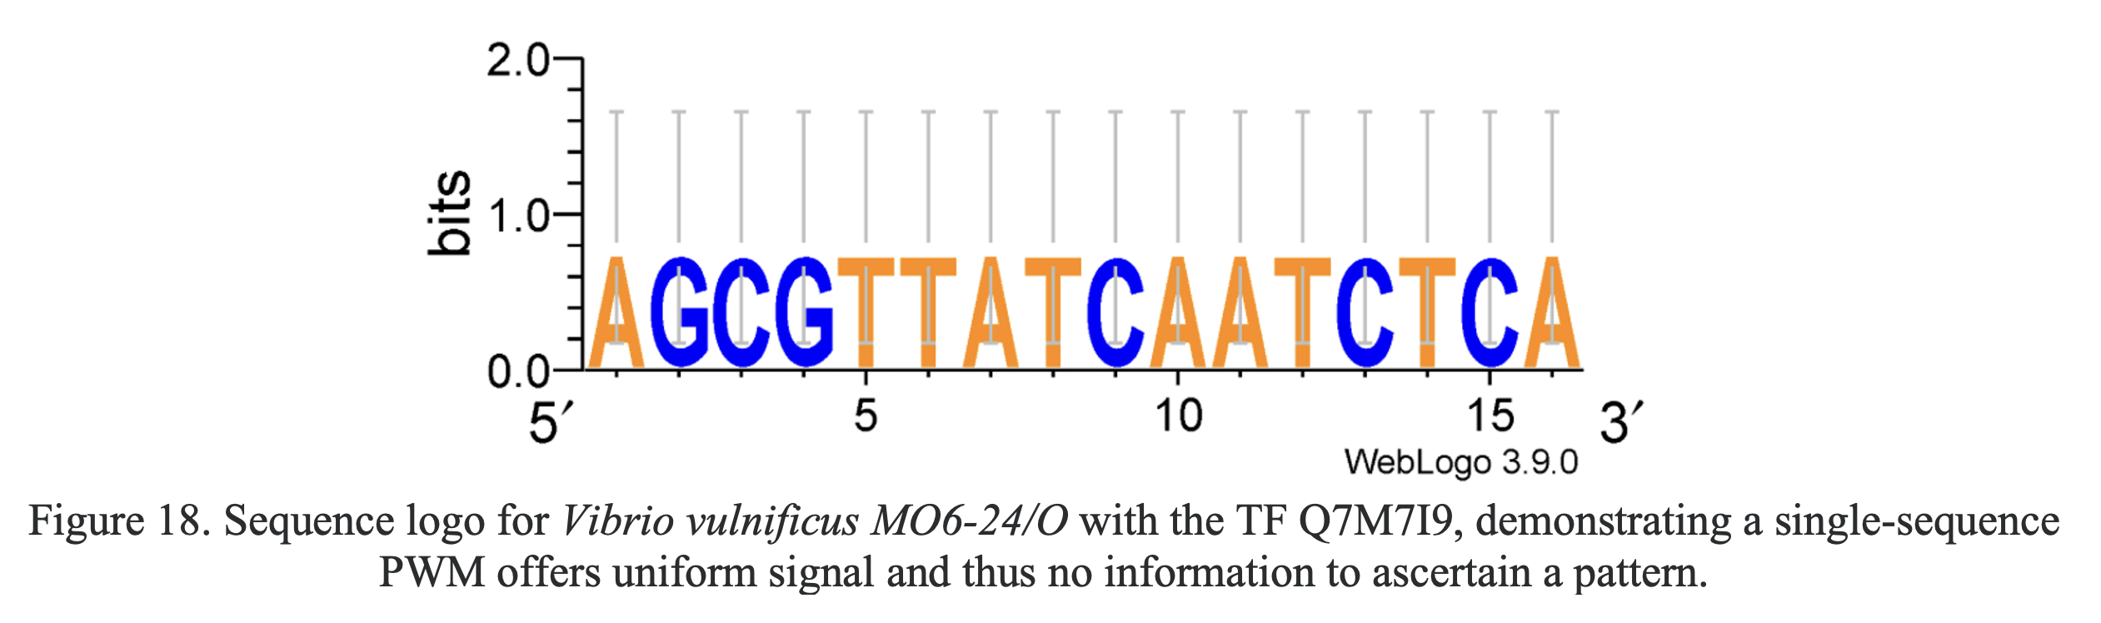
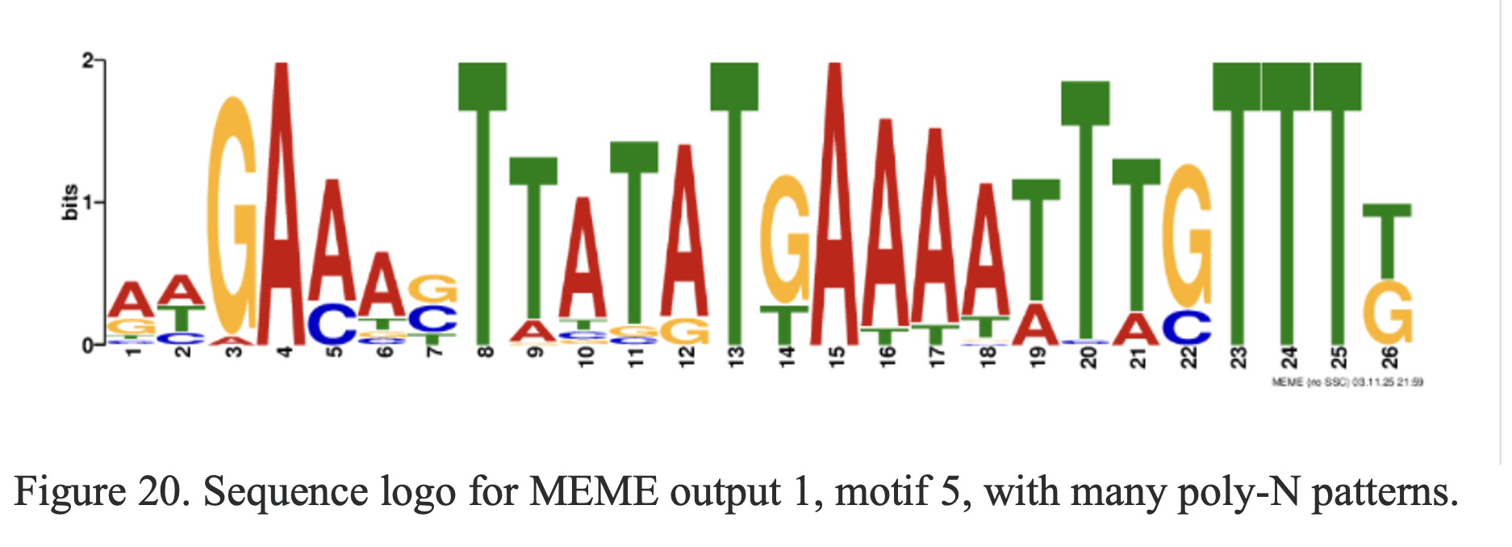
Exceptions and Edge Cases
Data scarcity and poly-N confounding
Notes:
With a single sequence. For this specific species, not clear what is signal vs noise as there’s only one sequence, can’t filter out flukes. The reliability and robustness is dubious as it’s not clear if this signal is a fluke or has legitimate noise across many sequences.
Poly- N --- winnowing out what’s a real vs fake pattern.

Slide 21
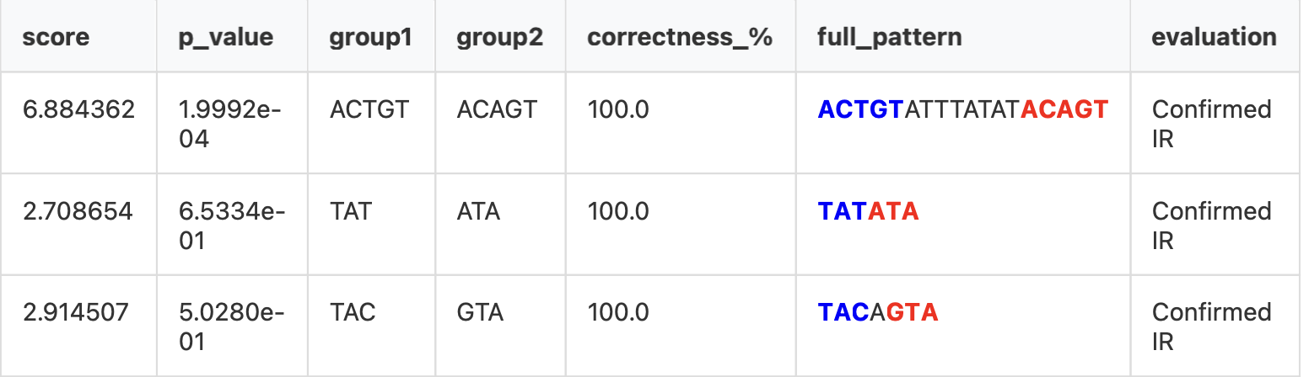
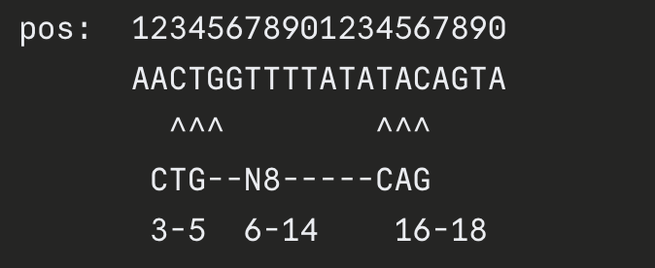
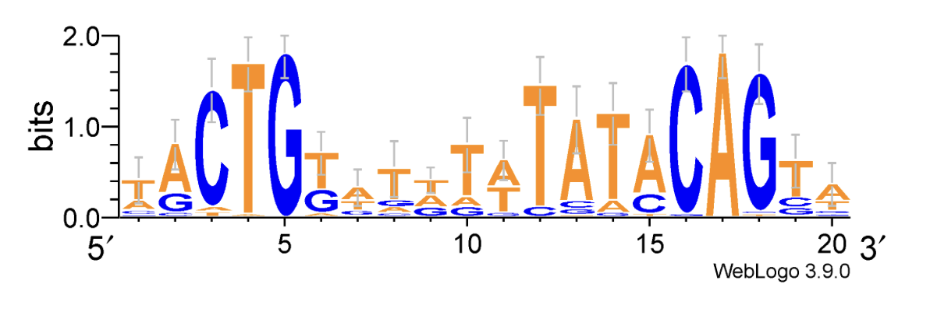
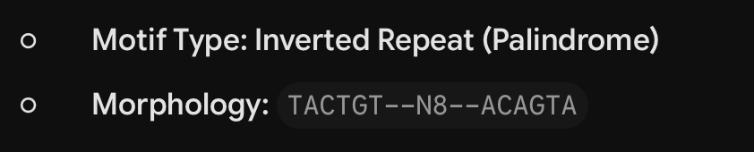
Conclusions
Leveraged Bacteria domain context with simple information-grounded methods
Future research areas: handling edge cases, test other families/domains, larger inputs
Why not ML/DL – need lots of labeled data to perform classification and return candidates
Why not LLMs – single case took 2-3 minutes (vs. 0.6 s) & inconsistent, but could improve with tool use
Notes:
TF_LexA_P0A7C2 -Escherichia_coli_str__K-12_substr__MG1655

Slide 22
Presentation Bibliography
“Figure 13.1: Transcription and translation process. The picture shows...,” ResearchGate. Accessed: Jun. 11, 2026. [Online]. Available: https://www.researchgate.net/figure/Transcription-and-translation-process-The-picture-shows-the-transcription-factors-TF_fig7_249656139
G. Mazón, I. Erill, S. Campoy, P. Cortés, E. Forano, and J. Barbé, “Reconstruction of the evolutionary history of the LexA-binding sequence,” Microbiology, vol. 150, no. 11, pp. 3783–3795, 2004, doi: 10.1099/mic.0.27315-0.
G. Tulin, N. Figueroa, S. Checa, and F. Soncini, “The multifarious MerR family of transcriptional regulators,” Molecular Microbiology, vol. 121, p. n/a-n/a, Dec. 2023, doi: 10.1111/mmi.15212.
T. L. Bailey and C. Elkan, “Fitting a mixture model by expectation maximization to discover motifs in biopolymers,” Proc Int Conf Intell Syst Mol Biol, vol. 2, pp. 28–36, 1994.

